Slide 1

Doub less Living!
The Gospel of
LUKE
That you may have certainty!

Slide 2
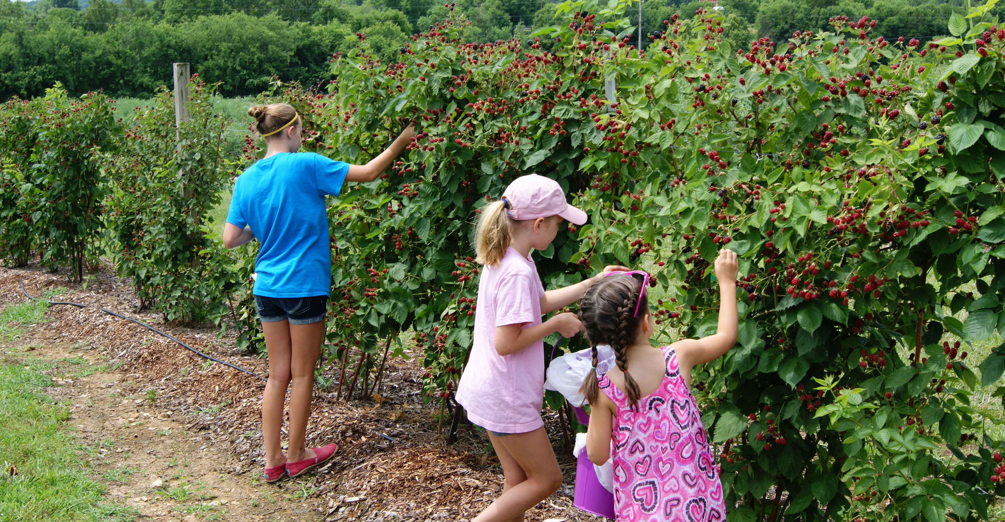

Slide 3
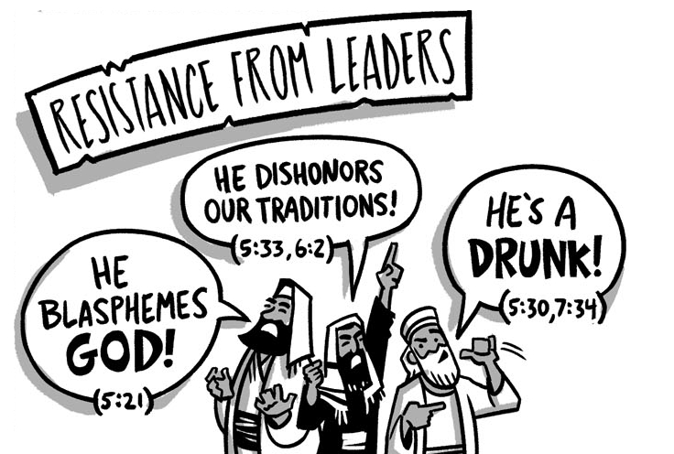

The Rise of Opposition
Five Controversies
Part Three
Luke 6:1-5
Deuteronomy 23:25
Exodus 20:8-11

Slide 4
The Rise of Opposition 5 Controversies
❺
❹
Healing Luke 6:6-11
❸
Picking Grain Luke 6:1-5
❷
Fasting Luke 5:33-39
❶
Associating with Sinners Luke 5:27-32
Forgiving Sins Luke 5:27-32
Sabbath

Slide 5
Controversy Over Picking Grain Luke 6:1-5 (CSB)
¹ On a Sabbath, he passed through the grainfields. His disciples were picking heads of grain, rubbing them in their hands, and eating them. ² But some of the Pharisees said, "Why are you doing what is not lawful on the Sabbath?“
³ Jesus answered them, "Haven't you read what David and those who were with him did when he was hungry— ⁴ how he entered the house of God and took and ate the bread of the Presence, which is not lawful for any but the priests to eat? He even gave some to those who were with him." ⁵ Then he told them, "The Son of Man is Lord of the Sabbath."

Slide 6

Controversy Over Picking Grain Luke 6:1-5 (CSB)
¹ On a Sabbath, he passed through the grainfields. His disciples were picking heads of grain, rubbing them in their hands, and eating them. ² But some of the Pharisees said, "Why are you doing what is not lawful on the Sabbath?“
Were the disciples stealing from the landowners by plucking grain and eating it as they passed by the field?
Deuteronomy 23:25: When you enter your neighbor's standing grain, you may pluck heads of grain with your hand, but do not put a sickle to your neighbor's grain.

Slide 7

Controversy Over Picking Grain Luke 6:1-5 (CSB)
¹ On a Sabbath, he passed through the grainfields. His disciples were picking heads of grain, rubbing them in their hands, and eating them. ² But some of the Pharisees said, "Why are you doing what is not lawful on the Sabbath?“
So, if they weren’t stealing, then why are the Pharisees so upset with Jesus and His disciples?
Exodus 20:8-11: ⁸Remember the Sabbath day, to keep it holy: ⁹You are to labor six days and do all your work, ¹⁰but the seventh day is a Sabbath to the LORD your God. You must not do any work… the LORD blessed the Sabbath day and declared it holy.

Slide 8

Controversy Over Picking Grain Luke 6:1-5 (CSB)
¹ On a Sabbath, he passed through the grainfields. His disciples were picking heads of grain, rubbing them in their hands, and eating them. ² But some of the Pharisees said, "Why are you doing what is not lawful on the Sabbath?“
The Pharisees believed that Jesus and His disciples were breaking the law by working on the Sabbath?
So, how did Jesus respond to their accusation?

Slide 9

Controversy Over Picking Grain Luke 6:1-5 (CSB)
³ Jesus answered them, "Haven't you read what David and those who were with him did when he was hungry— ⁴ how he entered the house of God and took and ate the bread of the Presence, which is not lawful for any but the priests to eat? He even gave some to those who were with him."
What does Jesus mean by this response; He admits David’s actions were unlawful.
Observation
David put human need above ritual law. He abided by the spirit of the Law, not the letter of the Law. And the Priests allowed it.
So, is Jesus saying the end justifies the means? Is he saying the Law is irrelevant?

Slide 10

Controversy Over Picking Grain Luke 6:1-5 (CSB)
³ Jesus answered them, "Haven't you read what David and those who were with him did when he was hungry— ⁴ how he entered the house of God and took and ate the bread of the Presence, which is not lawful for any but the priests to eat? He even gave some to those who were with him."
By now the Pharisees heads were spinning and their anger raging. They had to be thinking; who is this man who compares himself to our king and claims to be above the Law?

Slide 11


Controversy Over Picking Grain Luke 6:1-5 (CSB)
⁵ Then he told them, "The Son of Man is Lord of the Sabbath."
Jesus answers their unspoken question with two bold claims:
Pharasaic Minds Blown
Only God can make these claims.
He is the Son of Man
He is Lord of the Sabbath
Mark 2:27: “Then he told them, "The Sabbath was made for man and not man for the Sabbath.”

Slide 12


Deliberate Discipleship
Is the Son of Man Lord of your Sabbath? How can you honor Him this Sabbath day and avoid treating it just like any other day?
Where are we more concerned about keeping rules than we are about the welfare of God’s people?
Whom among your closest friends and associates needs you to come along side them in their time of need like Jesus did for His disciples?
Which of them is spiritually hungry and needs to know more about this Jesus who is Lord of your life?

Slide 13
The Rise of Opposition
Five Controversies
Part Four
Luke 6:6-11

